Slide 1
NexGen Resume Parser
Team Details:
Ani Reddy Saikiran Reddy(21EG505802)
S.Venkatesh(21EG505863)
P.Nikhil(21EG505856)
Project Supervisor
Name: Ms. A.Durga Bhavani
Designation: Assistant Professor

Slide 2
Introduction
Introducing "NexGen Resume Parser": a revolutionary platform reshaping recruitment through advanced NLP techniques. This system utilizes sophisticated algorithms to thoroughly analyze resumes, evaluating educational backgrounds, professional experiences, and additional qualifications. Notably, it provides candidates with an ATS (Applicant Tracking System) score, a comprehensive assessment of their profile's compatibility with job prerequisites, delivering invaluable insights.
Beyond assessment, the platform actively supports candidates by offering direct links to recent job openings aligned with their skills and experience. Tailored job recommendations, based on individual resumes, ensure a personalized job search. What sets "NexGen Resume Parser" apart is its proactive approach is once the ATS score is obtained, it's seamlessly sent to the candidate's email. This feature enhances the candidate experience by providing instant feedback and empowering them with insights for continuous improvement. With intelligent algorithms and comprehensive analysis, this platform optimizes the matching process, fostering meaningful connections between talent and employment opportunities.

Slide 3
Problem Statement
Traditional recruitment processes are sluggish, struggling to quickly identify ideal candidates. Job seekers lack personalized guidance and real-time feedback on applications. Existing Applicant Tracking Systems (ATS) fall short in providing immediate insights into compatibility. "NexGen Resume Parser" revolutionizes this landscape, leveraging advanced NLP for comprehensive resume analysis and offering a seamless, proactive job search experience. It bridges the gap between talent and opportunities, transforming recruitment into a more efficient and empowering process.

Slide 4
Proposed Method
Efficient Resume Analysis: Utilize advanced NLP techniques and sophisticated algorithms to ensure a thorough and efficient analysis of resumes, encompassing educational backgrounds, professional experiences, and additional qualifications.
Offering proactive candidate support: The platform provides direct links to relevant job openings and implements a tailored job recommendation system based on individual resumes, ensuring a personalized and efficient job search experience."
Instant Feedback and Empowerment: Differentiate "NexGen Resume Parser" by seamlessly sending the ATS score to candidates' emails, providing instant feedback and empowering them with actionable insights for continuous improvement in their job search strategies.
ATS Score Generation: Implement an Applicant Tracking System (ATS) score mechanism to provide candidates with a comprehensive assessment of their profile's compatibility with job prerequisites, offering valuable insights for both employers and job seekers.

Slide 5
Proposed Method
User uploads
resume
Resume analysis
Job Title Match
Recent Job Links for Job Title
View ATS Score
ATS Report
Resume Report

Slide 6
Experiment Environment
Tools:
Vs Code Editor
Language:
Python

Slide 7
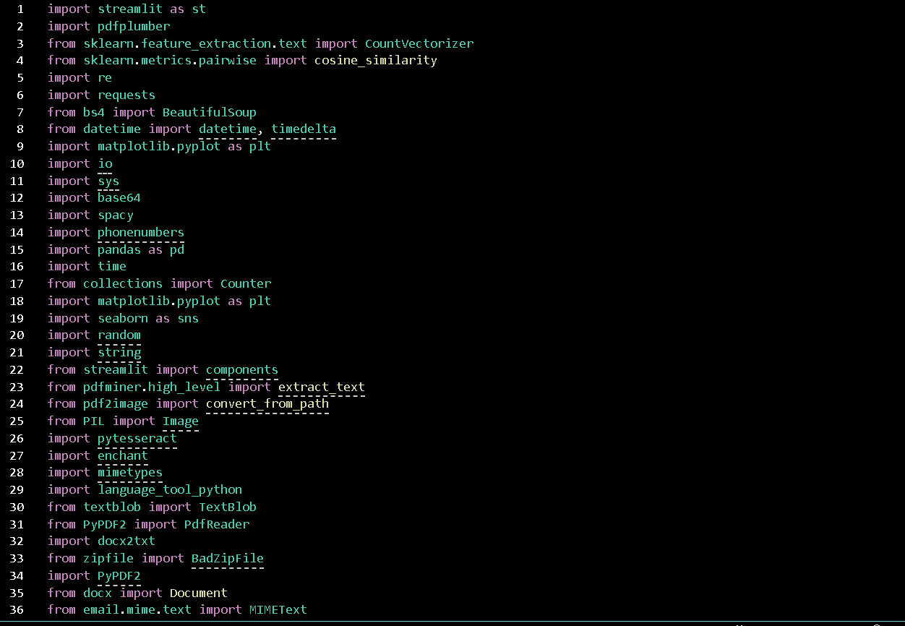
Experiment Screenshots

Slide 8
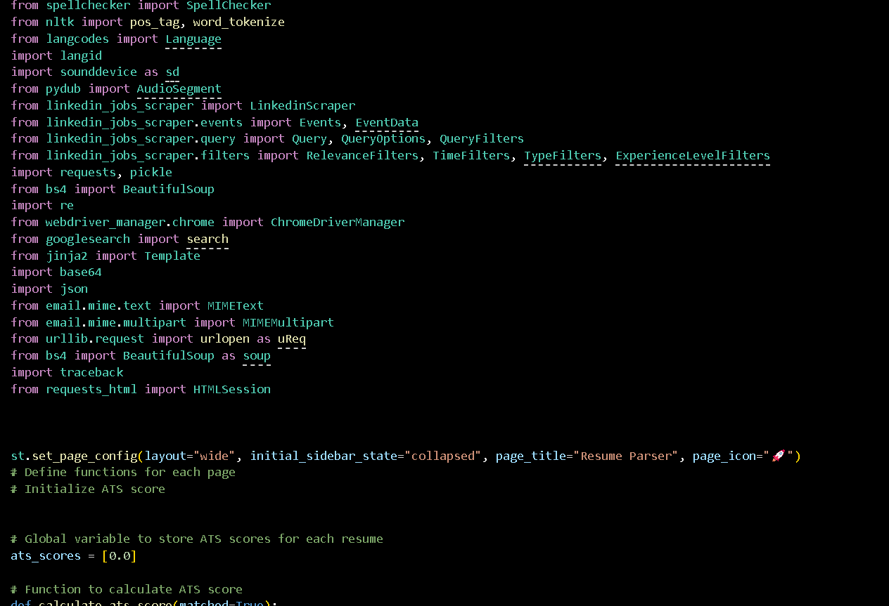
Experiment Screenshots

Slide 9
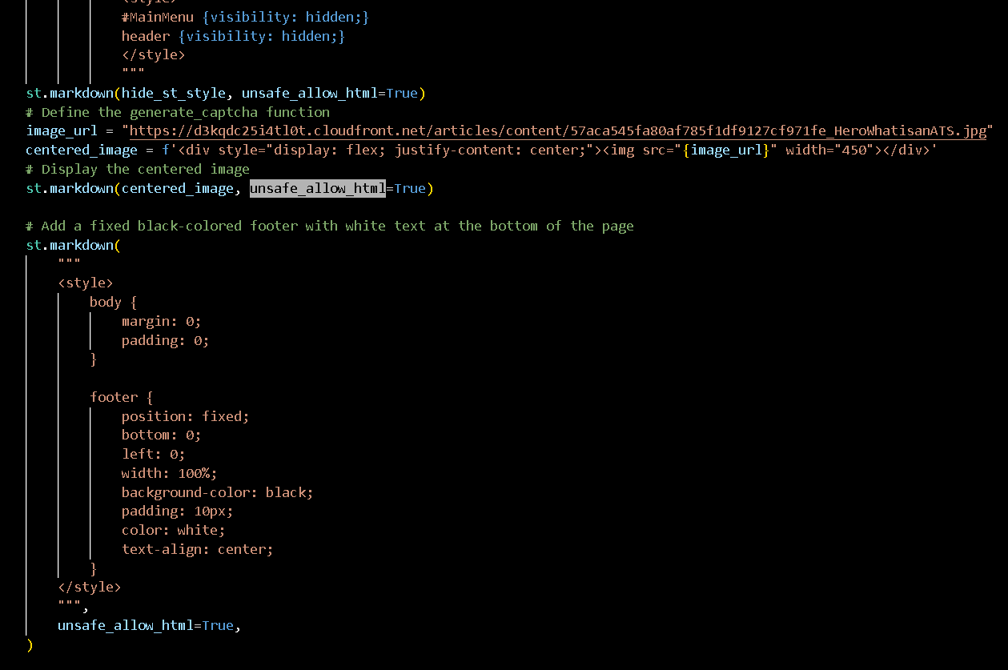
Experiment Screenshots

Slide 10
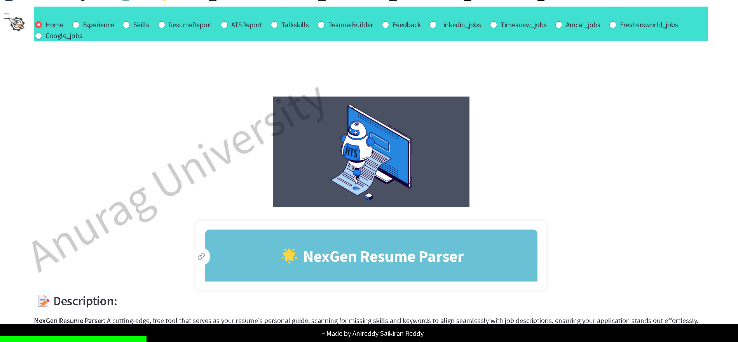
Experiment Result

Slide 11
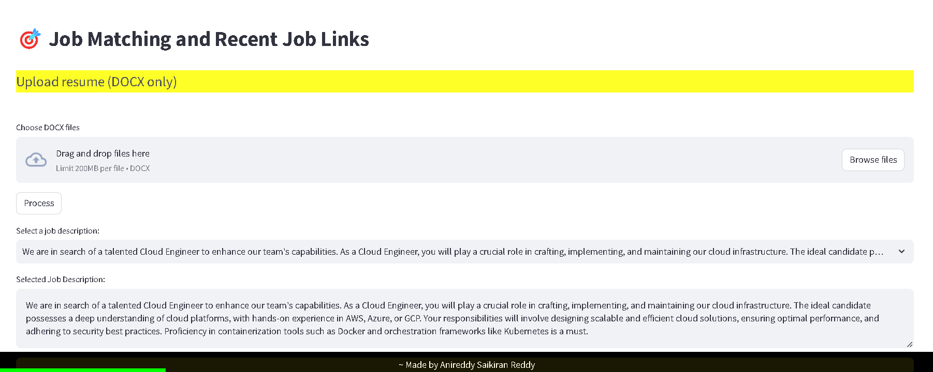
Experiment Result

Slide 12
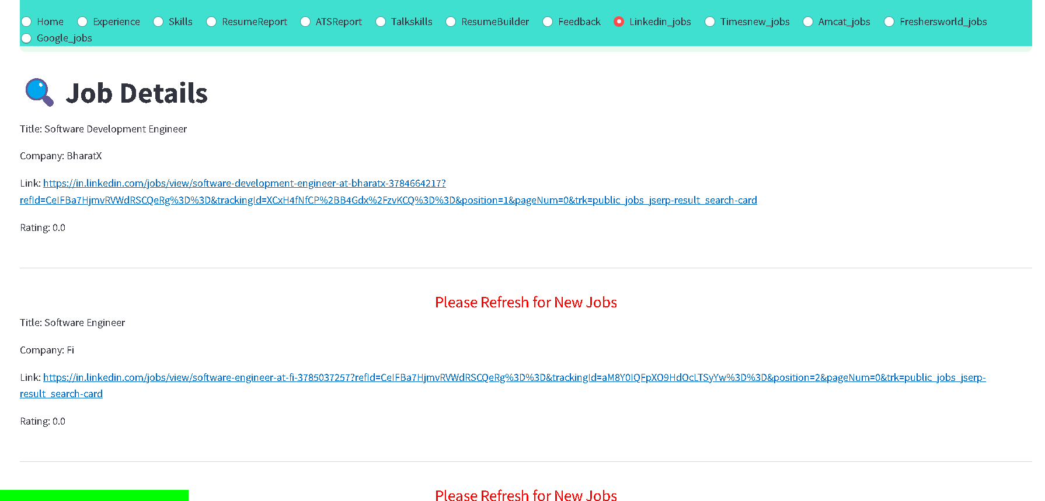
Experiment Result

Slide 13
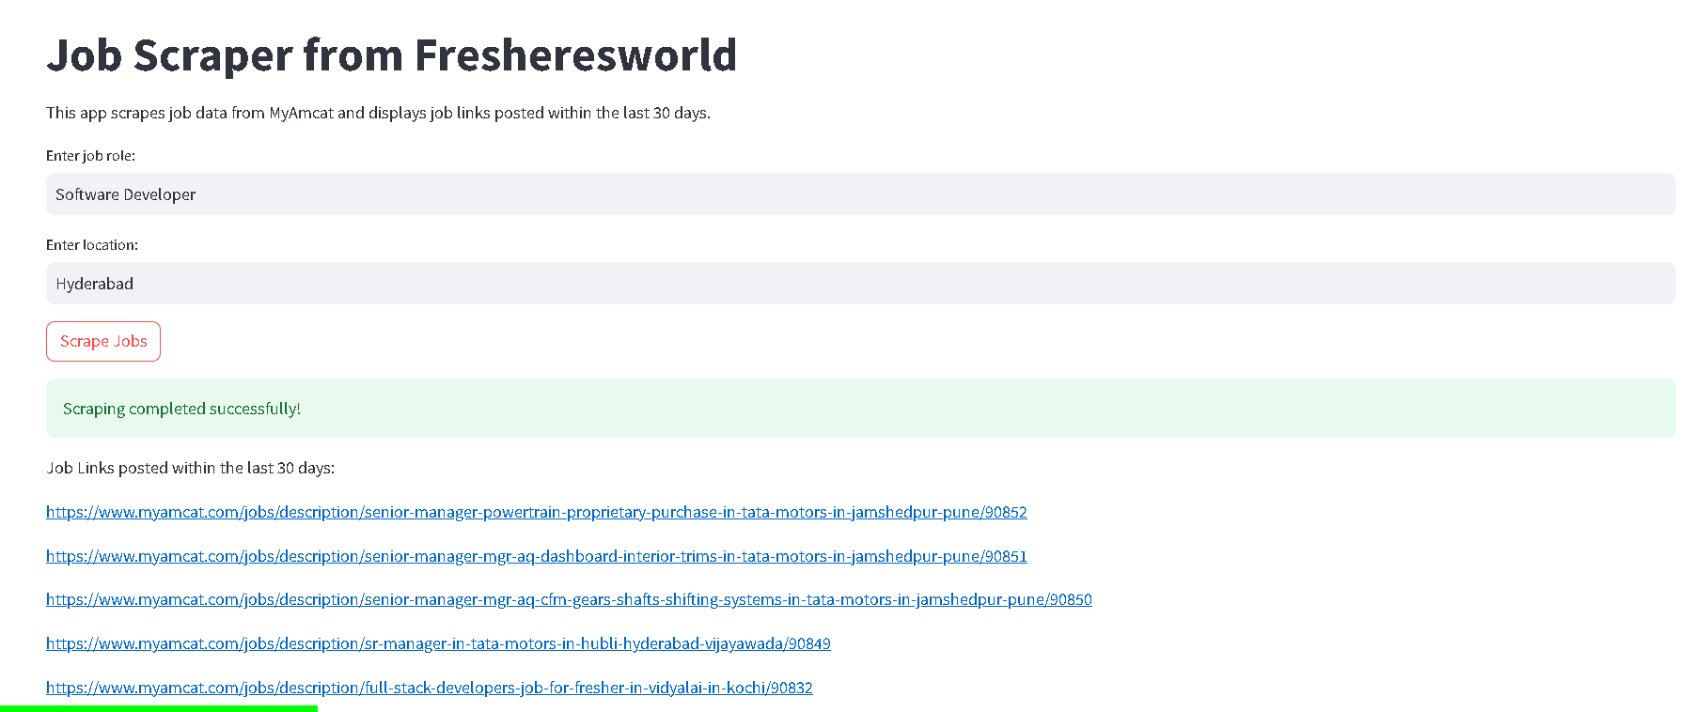
Experiment Result

Slide 14
Finding
"Traditional recruitment processes are sluggish, struggling to quickly identify ideal candidates."
"Job seekers lack personalized guidance and real-time feedback on applications."
"Existing Applicant Tracking Systems (ATS) fall short in providing immediate insights into compatibility."
"NexGen Resume Parser revolutionizes this landscape, leveraging advanced NLP for comprehensive resume analysis and offering a seamless, proactive job search experience."

Slide 15
Justification
1.What are parameters improved by your method?
Accuracy

Slide 16
Thank You

